Slide 1
STRUCTURE IN C
Dr. S. Vinila Jinny

Slide 2
INTRODUCTION
At times, during programming, there is a need to store multiple logically related elements under one roof.
For instance, an employee’s details like name, employee number, and designation need to be stored together.
In such cases, the C language provides structures to do the job for us.

Slide 3
WHAT IS STRUCTURE?
The structure is a user-defined data type in C, which is used to store a collection of different kinds of data.
The structure is something similar to an array; the only difference is array is used to store the same data types.
struct keyword is used to declare the structure in C.
Variables inside the structure are called members of the structure.

Slide 4
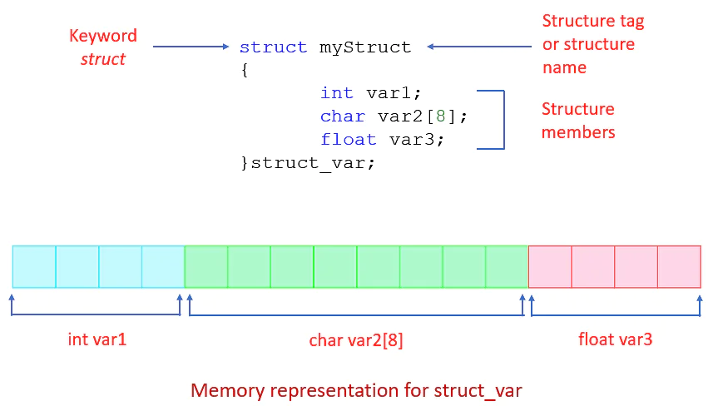
STRUCTURE DEFINITION

Slide 5
STRUCTURE EXPLANATION
A structure can be defined as a single entity holding variables of different data types that are logically related to each other.
All the data members inside a structure are accessible to the functions defined outside the structure. To access the data members in the main function, you need to create a structure variable.

Slide 6
Syntax to Define a Structure in C
struct structName
{
// structure definition
Data_type1 member_name1;
Data_type2 member_name2;
Data_type2 member_name2;
};

Slide 7
Description of the Syntax
Keyword struct: The keyword struct is used at the beginning while defining a structure in C.
structName: This is the name of the structure which is specified after the keyword struct.
data_Type: The data type indicates the type of the data members of the structure. A structure can have data members of different data types.
member_name: This is the name of the data member of the structure. Any number of data members can be defined inside a structure. Each data member is allocated a separate space in the memory.

Slide 8
Example
struct employee
{ int id;
char name[10];
float salary;
};

Slide 9
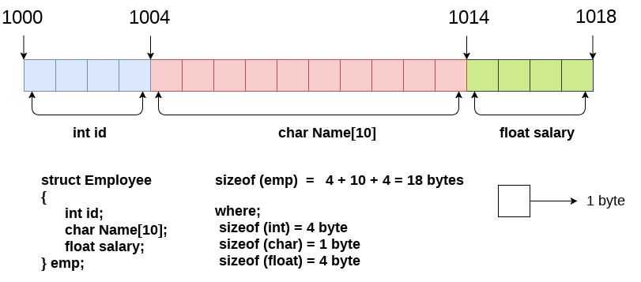
Example-memory representation

Slide 10
Declaring structure variable
We can declare a variable for the structure so that we can access the member of the structure easily.
There are two ways to declare structure variable:
By struct keyword within main() function
By declaring a variable at the time of defining the structure.

Slide 11
Declaring structure variable
1st way:
Let's see the example to declare the structure variable by struct keyword. It should be declared within the main function.
struct employee
{ int id;
char name[50];
float salary;
};
int main(){
struct employee e1, e2;
return 0; }

Slide 12
Declaring structure variable
2nd way:
Let's see another way to declare variable at the time of defining the structure.
struct employee
{ int id;
char name[50];
float salary;
}e1,e2;

Slide 13
Accessing members of the structure
There are two ways to access structure members:
By . (member or dot operator)
By -> (structure pointer operator)

Slide 14
Example
#include<stdio.h>
#include <string.h>
struct employee
{ int id;
char name[50];
}e1;
int main( )
{
e1.id=101;
strcpy(e1.name, "Sonoo Jaiswal");
printf( "employee 1 id : %d\n", e1.id);
printf( "employee 1 name : %s\n", e1.name);
return 0;
}
employee 1 id : 101
employee 1 name : Sonoo Jaiswal

Slide 15
STRUCTURE POINTERS
Structure pointers are pointer variables that holds the address of another variable.
Syntax:
struct structure_name *ptr;
To access members of structure using the structure variable, we used the dot . operator. But when we have a pointer of structure type, we use arrow -> to access structure members.

Slide 16
STRUCTURE POINTERS
#include <stdio.h>
struct my_structure {
char name[20];
int number;
int rank;
};
int main()
{
struct my_structure variable = {“JACKIN", 35, 1};
struct my_structure *ptr;
ptr = &variable;
printf("NAME: %s\n", ptr->name);
printf("NUMBER: %d\n", ptr->number);
printf("RANK: %d", ptr->rank);
return 0;
}

Slide 17
STRUCTURE ASSIGNMENT
Structure variables can be assigned to another structure variable using assignment operator(=)
#include<stdio.h>
int main()
{
Struct sample
{
int a;
int b;
}x,y;
x.a=10;
x.b=200;
y=x;
printf(“%d %d”, y.a,y.b)
return 0;
}

Slide 18
ARRAY OF STRUCTURES
As normal varaiable, we can create array on structure variable.
Syntax:
struct structure_name variable[array size];

Slide 19
ARRAY OF STRUCTURES
void ask()
{
for(i = 0; i < 3; i++)
{
printf("\nEnter %dst Employee record:\n", i+1);
printf("\nEmployee name:\t");
scanf("%s", emp[i].ename);
printf("\nEnter Salary:\t");
scanf("%d", &emp[i].sal);
}
printf("\nDisplaying Employee record:\n");
for(i = 0; i < 3; i++)
{
printf("\nEmployee name is %s", emp[i].ename);
printf("\nSlary is %d", emp[i].sal);
}
}
#include<stdio.h>
struct Employee
{
char ename[10];
int sal;
};
struct Employee emp[5];
int i, j;
void main()
{
ask();
}

Slide 20
PASSING STRUCTURES TO FUNCTIONS
void show(struct Student st)
{
printf("\nstudent name is %s", st.name);
printf("\nroll is %d", st.roll);
}
#include<stdio.h>
struct Student
{
char name[10];
int roll;
};
void show(struct Student st);
void main()
{
struct Student std;
printf("\nEnter Student record:\n");
printf("\nStudent name:\t");
scanf("%s", std.name);
printf("\nEnter Student rollno.:\t");
scanf("%d", &std.roll);
show(std);
}

Slide 21
STRUCTURES WITHIN STRUCTURES
Nesting of structures, is also permitted in C language. Nested structures means, that one structure has another stucture as member variable.
struct complex
{
int imag;
float real;
};
struct number
{
struct complex comp;
int integers;
} nu;
nu.comp.imag = 11;

Slide 22
ARRAYS WITHIN STRUCTURES
A structure can have array as its member.
struct Student
{
int a[10][10];
float b;
}y;

